Slide 1

Recognition Framework
Skills4EOSC

Slide 2
Purpose of the Recognition Framework?
Define the use of digital credentials
To give Open Science professionals/experts proof of their skills
Instructors’ skills
Leaners’ skills
For employers to be able to recognize these skills across Europe

Slide 3









The process
---------------------
---------------------
FAIR-by-design methodology for learning material
Quality assurance for learning material
---------------------
---------------------
MVS define skills for Open Science profiles
The methodology defines the workflow for creating FAIR learning materials
QA Checklists to assess quality of learning materials
Learning material is developed
Credentials are issued after completing course + assessment

Slide 4
Digital Credentials for Attendance Only
PROs
CONs
Encourages Participation
Can motivate more individuals to participate in training sessions, as they receive recognition simply for being present.
Inclusivity
It allows all participants, regardless of their performance in assessments, to receive a credential, promoting inclusivity and reducing the pressure of assessment.
Easy to Administer
Straightforward to issue, as they do not require the evaluation of participant performance, reducing administrative overhead.
Building a Learning Culture
Can contribute to a culture of continuous learning, encouraging individuals to engage in more training opportunities.
Limited Value
Attendance may carry less weight since they do not necessarily indicate that the recipient has gained or demonstrated any specific skills or knowledge.
Potentially Misleading
Could be misleading if interpreted as a sign of competency when they only signify participation.
Lack of Differentiation
No distinction between those who merely attend and those who actively engage and master the material, potentially diminishing the credential’s perceived value.

Slide 5
Digital Credentials for Successful Completion of Assessment
PROs
CONs
Demonstrates Competency
Indicate that the recipient has not only attended the training but also successfully demonstrated understanding and application of the material, making them more meaningful and valuable.
Higher Recognition
Often more respected by employers and peers, as they provide evidence of skills and knowledge.
Motivates Learning
Knowing that they must pass an assessment to receive a credential can motivate participants to engage more deeply with the content.
Differentiates Skill Levels
Differentiates between those who have mastered the material and those who have not, which can be important in professional or academic settings.
Excludes Some Participants
Those who struggle with assessments may not receive a credential, which could discourage participation and be seen as less inclusive.
Increased Pressure
Participants may feel more stressed or anxious about assessments, which could negatively impact their learning experience.
More Complex Administration
Administering assessments and issuing credentials based on performance requires more resources, including time, effort, and sometimes technology, to ensure fair and accurate evaluation.
Risk of Credential Inflation
If not carefully designed, assessments could lead to credential inflation, where the credential becomes less valuable due to inconsistent or low standards.

Slide 6
Looking for a ….
standard
verifiable
portable
shareable
digital
micro-credentials
rich metadata

Slide 7
Results of the landscaping
OBERRED Open Badges
NI4OS-Europe Open Badges
The Carpentries Proprietary
RItrainPlus – Not decided
EC European Digital Credentials
NASA TOPS Open Badges
Linux Professional Institute Proprietary
Open Data Institute Proprietary
EOSC Future Open Badges
DC4EU European Digital Credentials
Digital Credentials Consortium Open Badges

Slide 8
Viable Options
Open Badges
EU Digital Credentials

Slide 9
What are Open Digital Badges?
created and issued to recognise
competencies
skills
achievements or
attitudes
a digital picture with metadata
informs who has issued the badge to whom and on what basis
standard and verifiable portable digital credential
metadata aligns with the Open Badges standard created by the Mozilla Foundation and further developed by IMS global

Slide 10
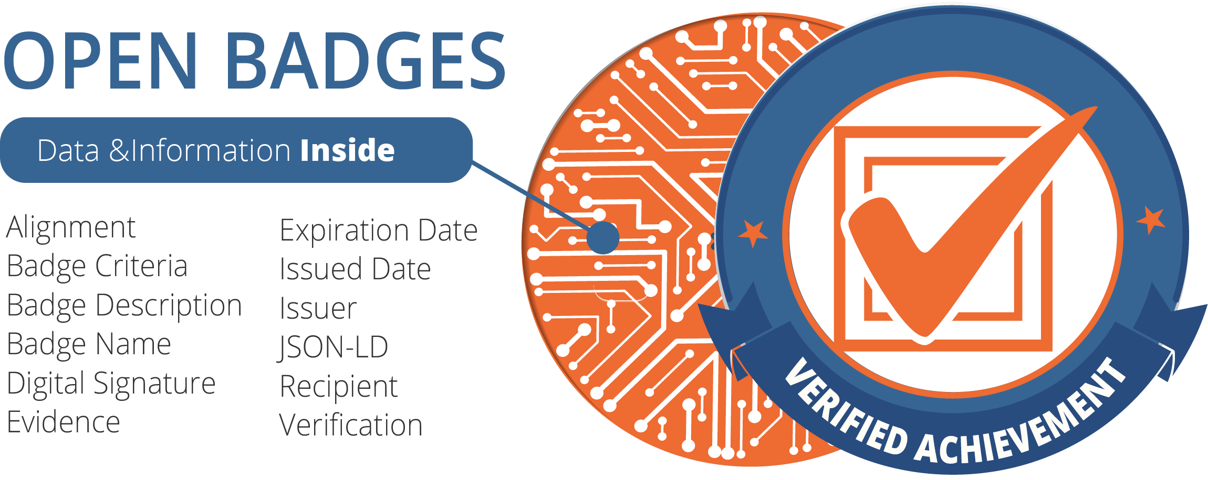
Open Badge Content
Image plus
name of the badge
description
creator write descriptions of the badge
criteria info
badge issuer presents the criteria used to recognise the skills, achievements or competences of the recipient
Open Badge content by 1EdTech, licensed under CC-BY-4.0

Slide 11

Gathering & Sharing Open Badges
Badges can be collected
in a backpack, passport, or wallet solution
https://badgr.com/
Collections can be created to group individual badges into categories
Badges can be shared on social media
People can click on an Open Badge, view all the evidence, read details about the achievement, and verify the badge's authenticity

Slide 12
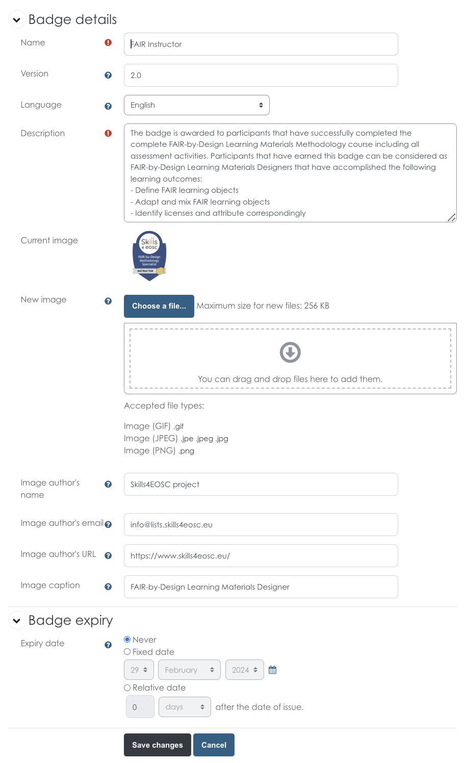
Issuing Open Badges
Can be integrated with a Learning Platform
Prepare the image using templates
Fill out the badge details
Issuing criteria
Manual
Automatic

Slide 13
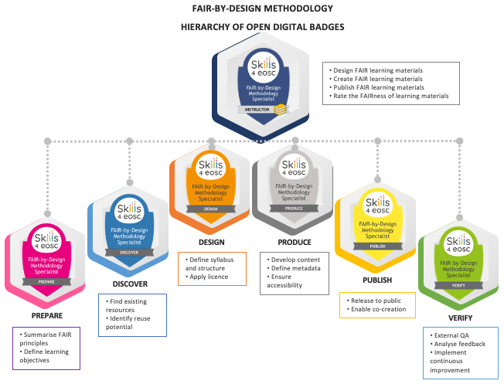
Using Hierarchical Badges
Define multiple badges within one training
Link each badge to a different set of micro-credentials
Higher-level badges are obtained once lower-level badges are issued

Slide 14
European Digital Credentials for learning
standardised
tamperproof
electronic documents
describing that their owner
has certain skills or has achieved certain learning outcomes
through formal, non-formal or informal learning context

Slide 15
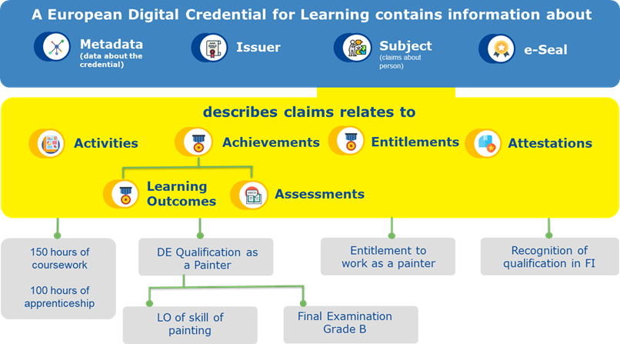
EDC content
Image taken from https://europa.eu/europass/en/stakeholders/european-digital-credentials

Slide 16
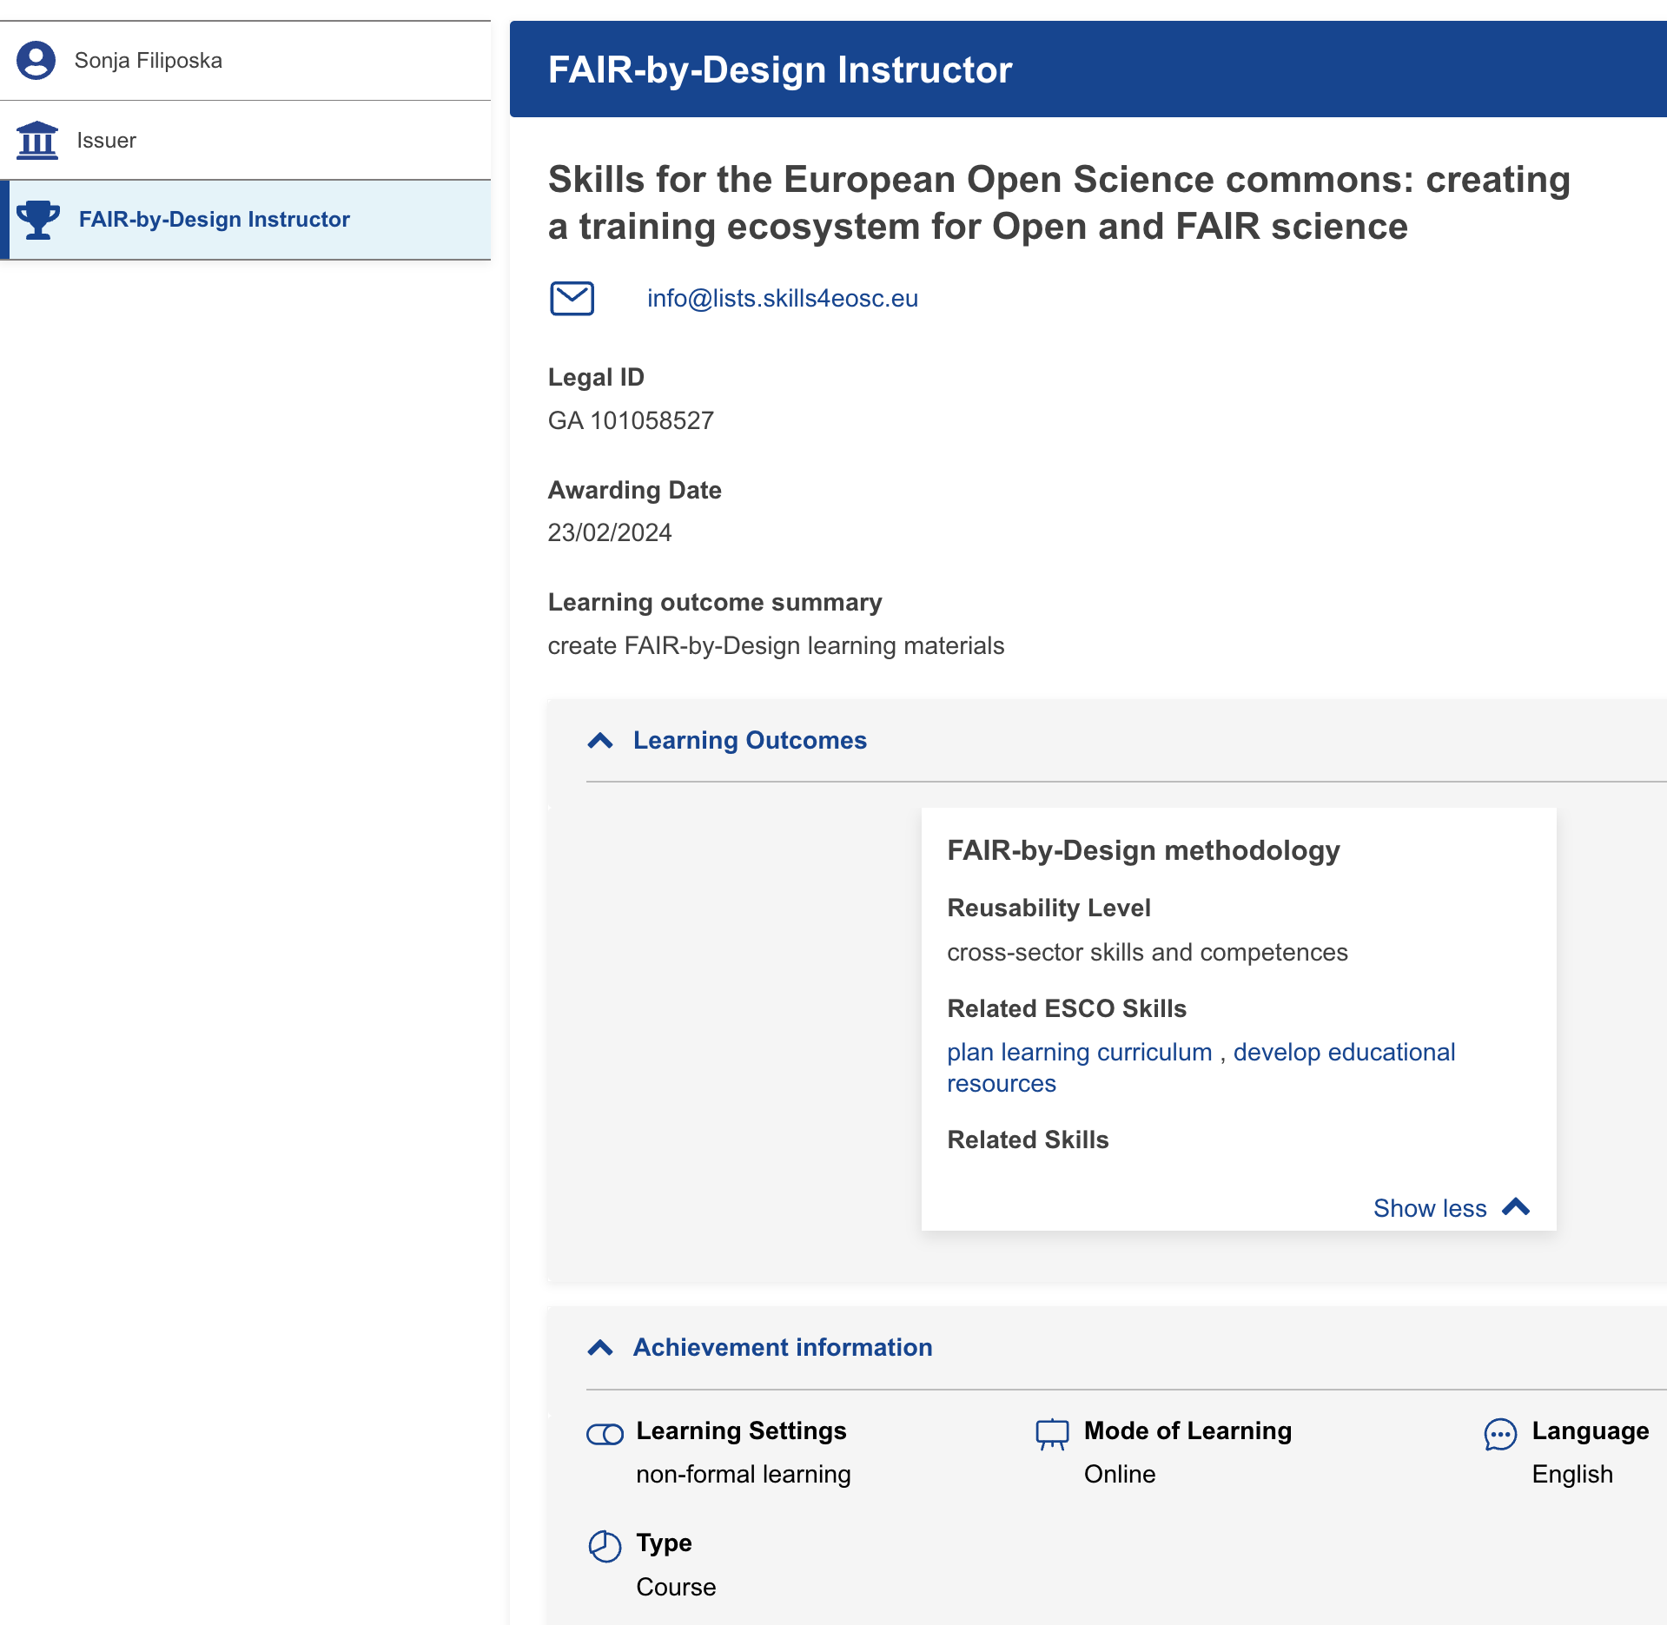
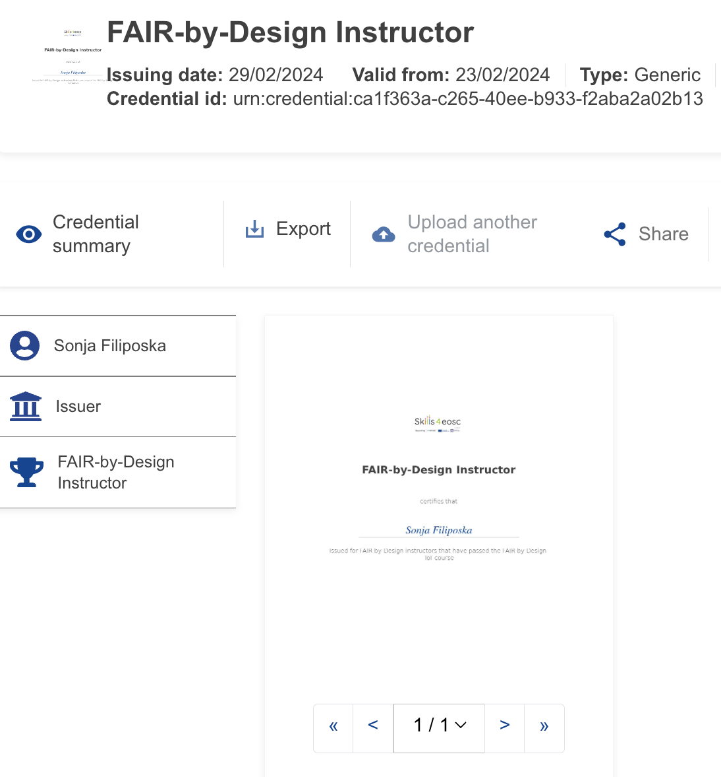
Credential example
Can be stored in a wallet integrated with europass

Slide 17
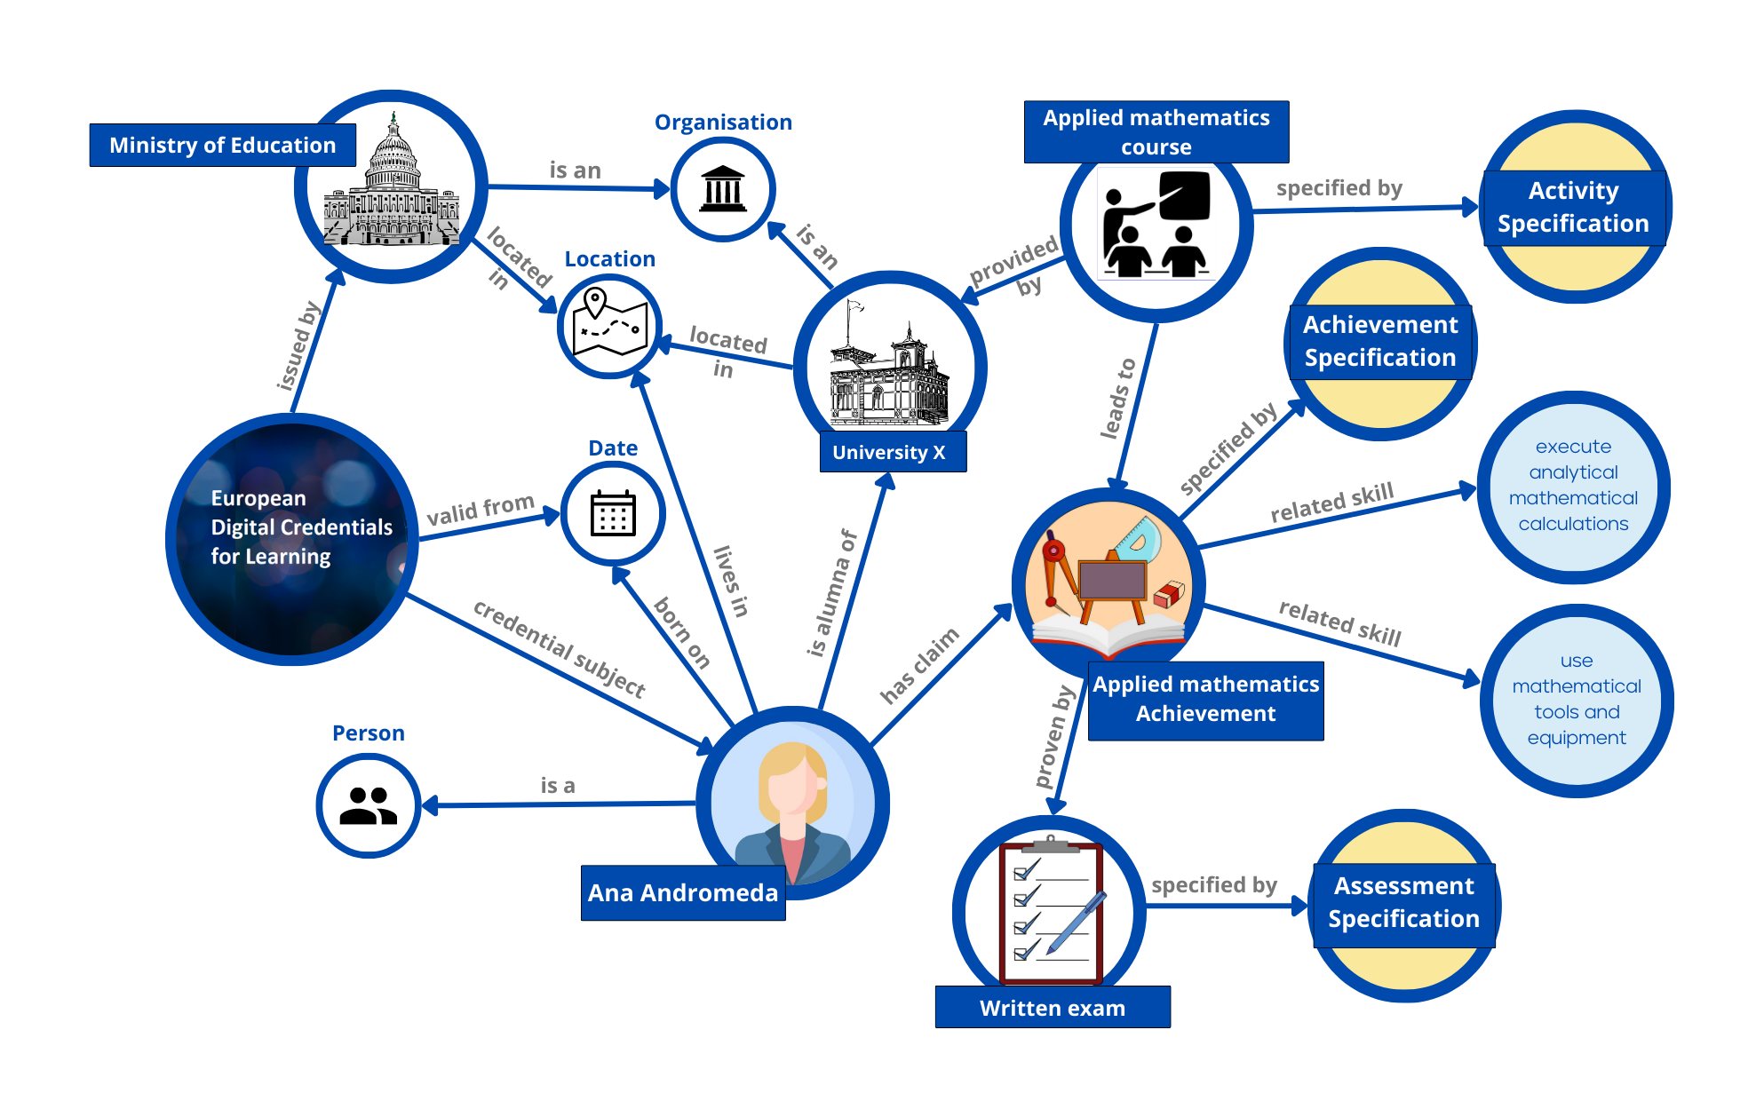
The European Learning Model (ELM)
Image by Europass taken from https://europa.eu/europass/en/node/2128

Slide 18
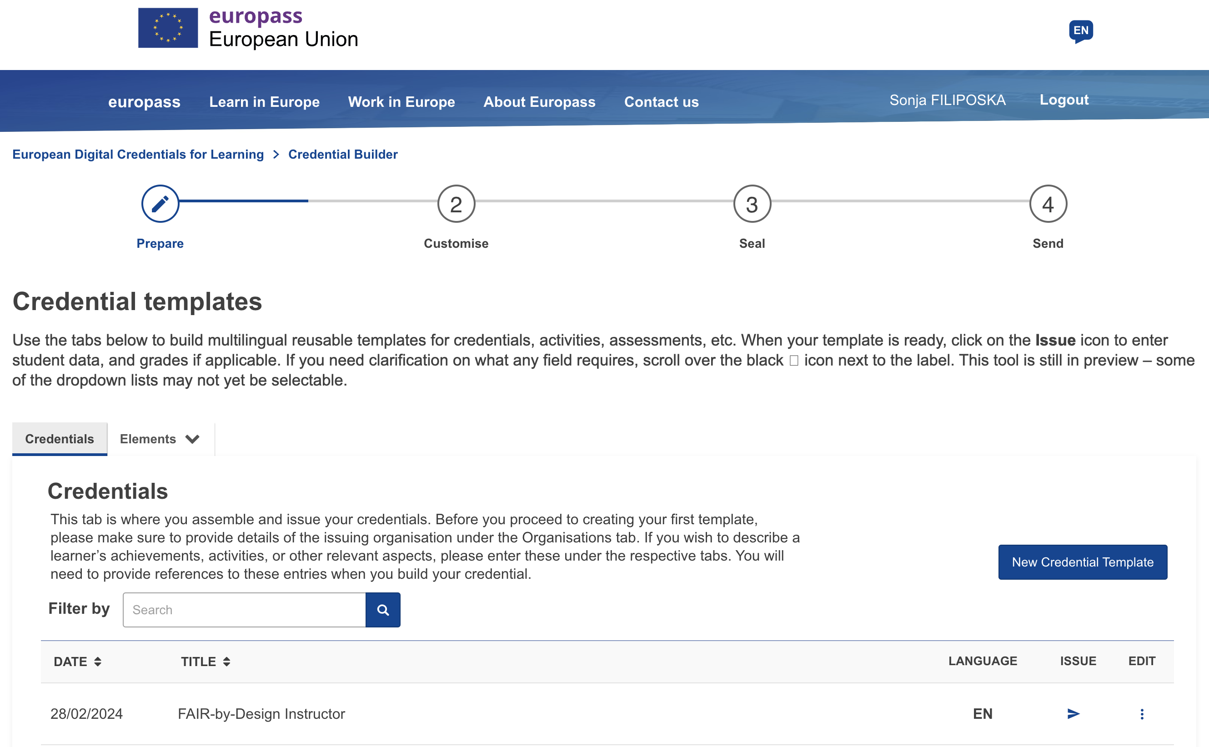
To issue an EDCs
The issuing institution needs to obtain a Qualified eSeal
Understand the ELM
Define (and customise) a template
Use the credential builder online
Prepare a list of receivers

Slide 19
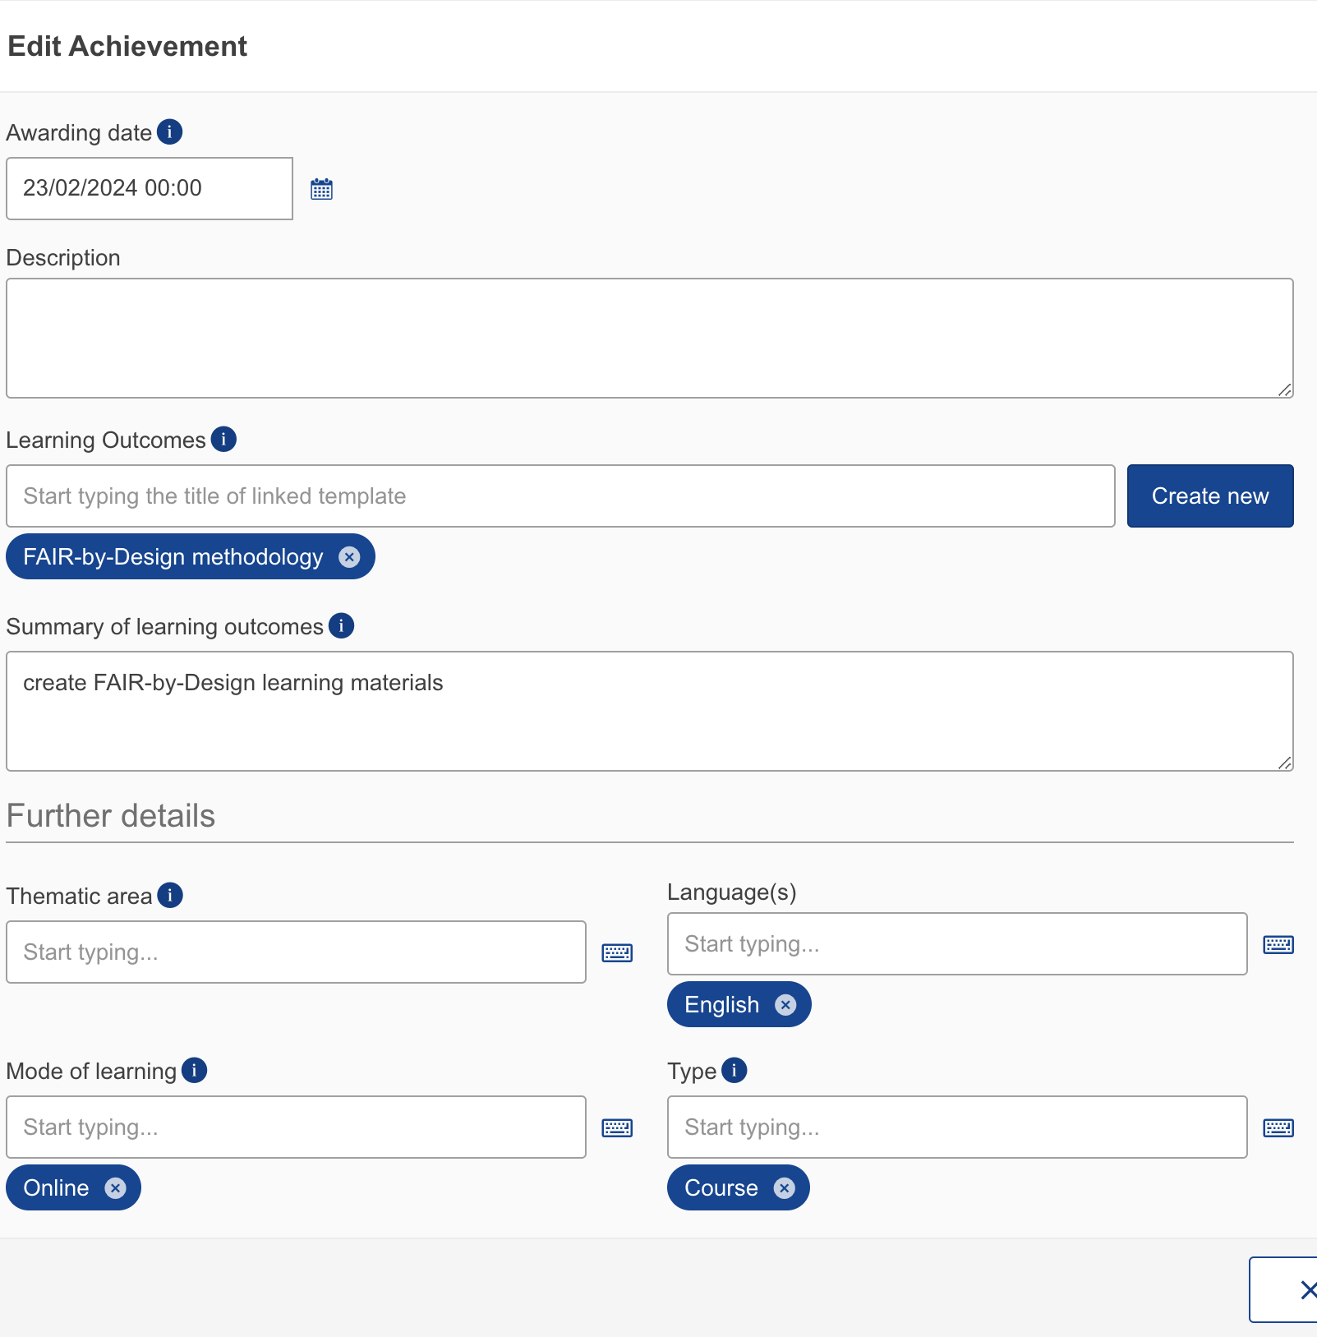
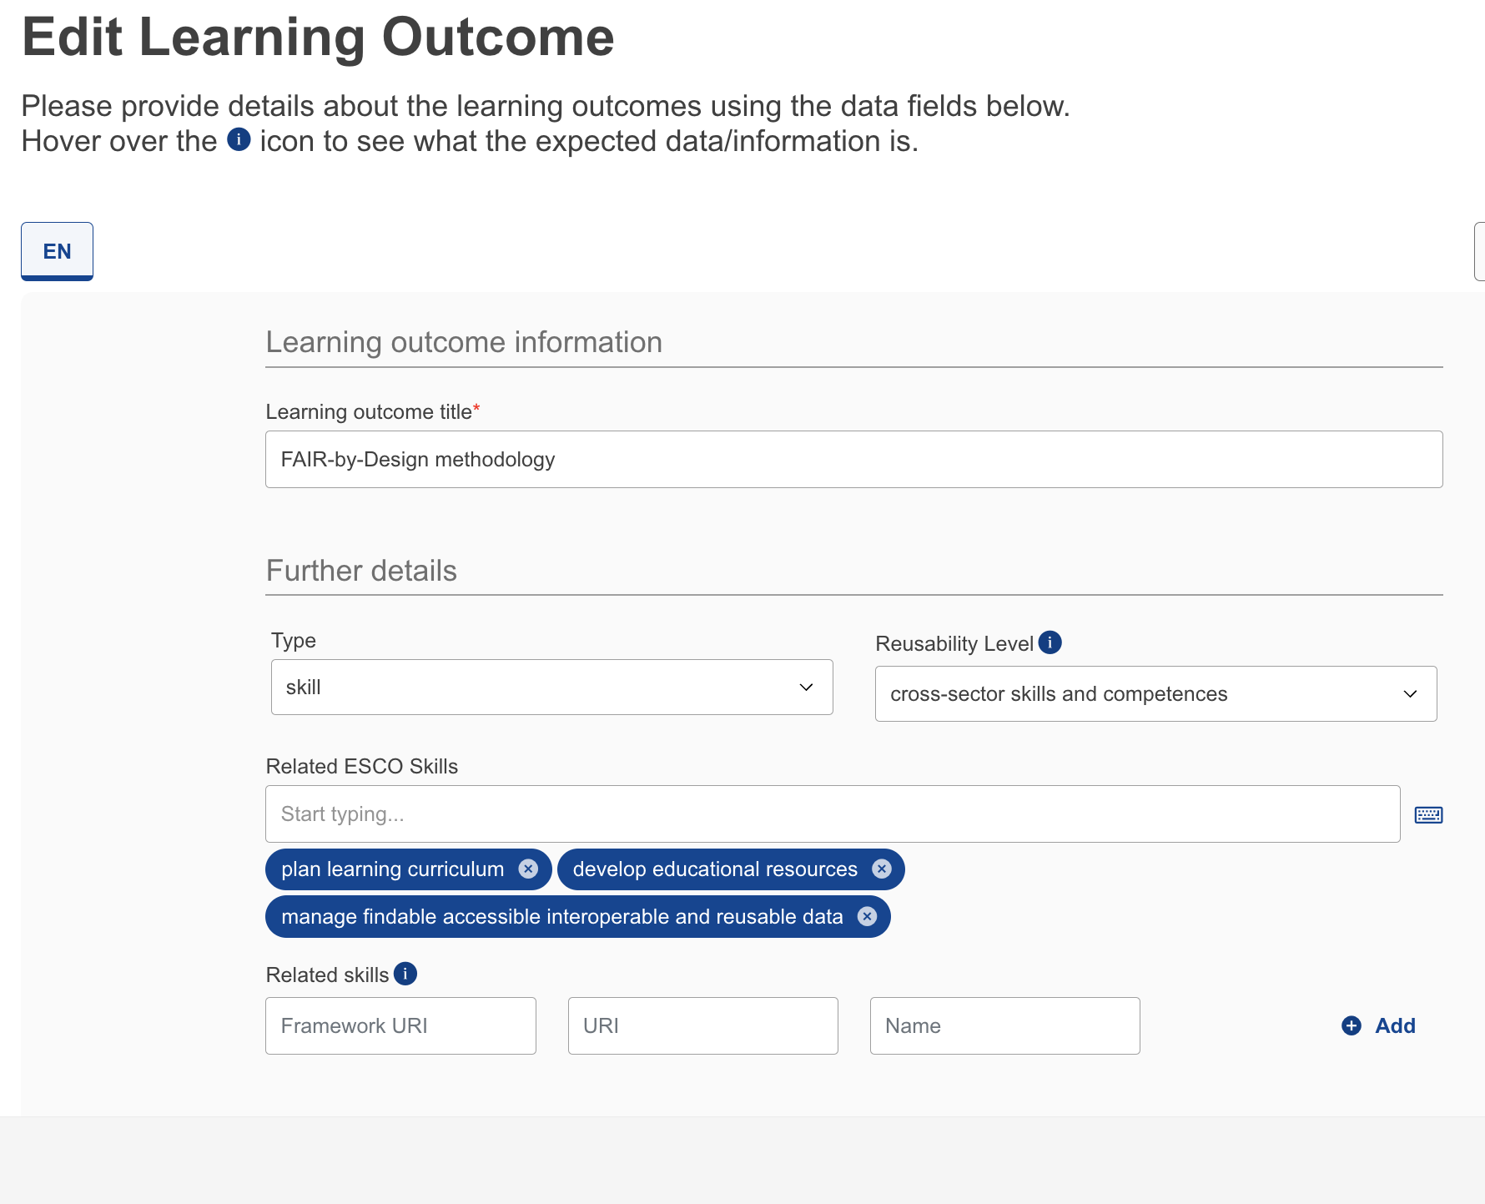
Defining a template (multilingual support)
Support for ontologies-based description of skills

Slide 20
Current state
Can not be seamlessly integrated with a learning platform
Issuer must buy the eSeal on a temporal basis
Defining detailed templates requires a lot of manual work
Others can prepare a template and send it to the issuing institution
Issuing is manual and needs to be done on regular basis
Possibility to automate with a local installation and extra effort

Slide 21
Final remarks: The approaches are
Complementary
Can be used in parallel

Slide 22
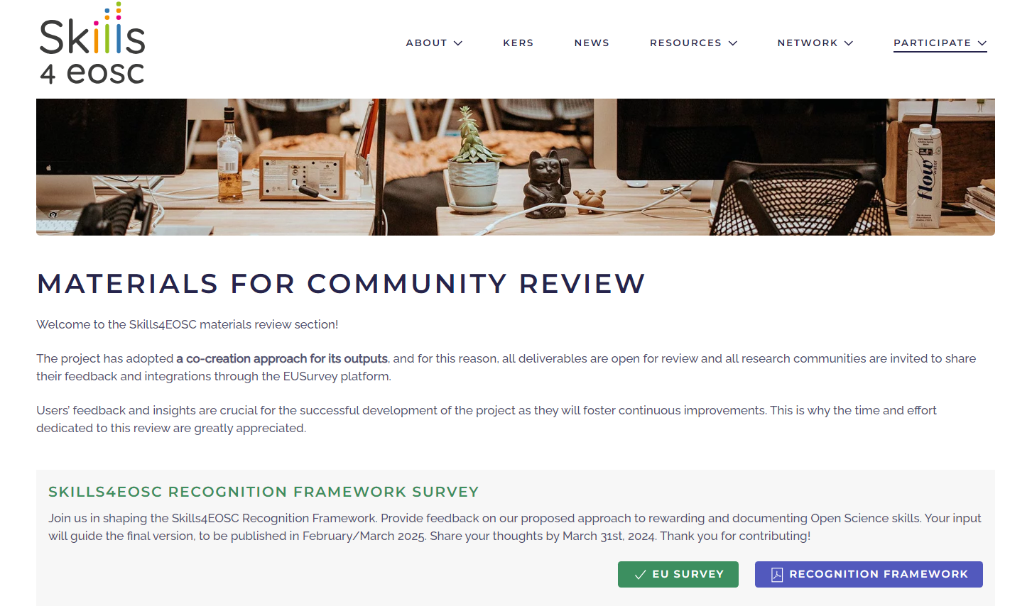
Materials for community review

Slide 23
Thank you! Questions?

